Slide 1

Integrating visual communication and storytelling in Software Engineering without being a pixel-pusher
Vaishnavi V

Slide 2


Disclaimer

Slide 3
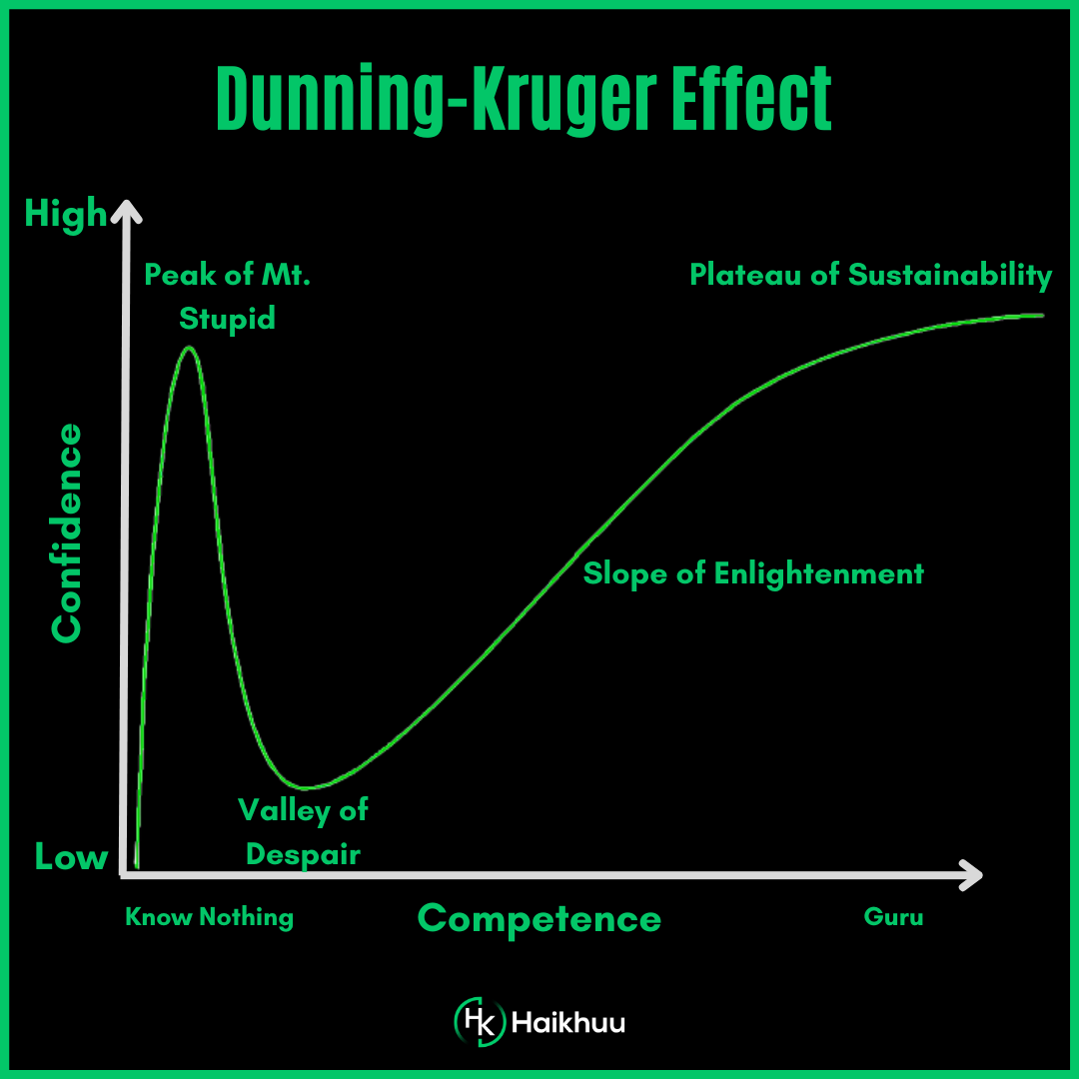
Dunning-Kruger effect

Slide 4
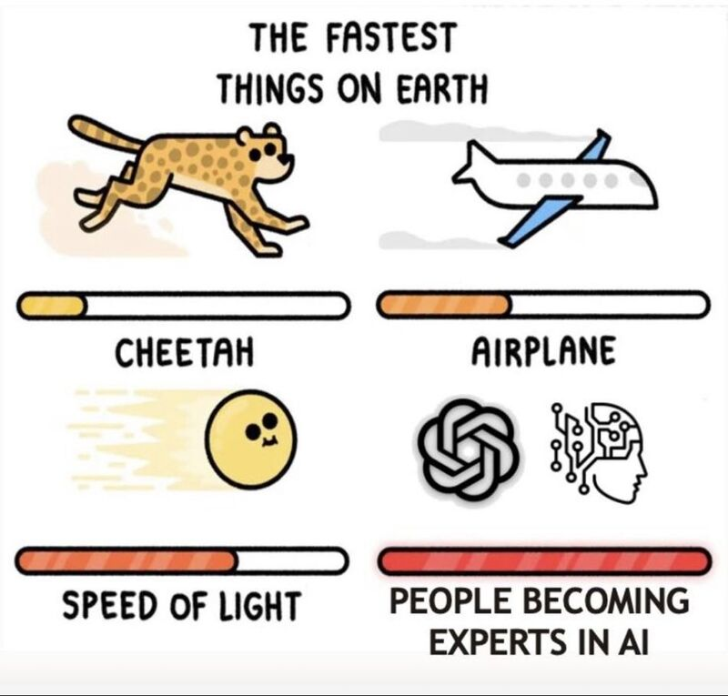
Not an expert!
Notes:
We're now witnessing the Dunning-Kruger effect in action and scale never seen before 😅
Remember - AI won't take your job but people who are "experts" in AI will 😉

Slide 5

Definition
Visual communication is the practice of using visual elements to get a message across, inspire change, or evoke an emotion.

Slide 6

Perfect MVP
Communication design refers to crafting a message that educates, motivates, and engages the viewer.
Graphic design uses design principles to communicate that message in a way that is clear and eye-catching to the intended audience.

Slide 7
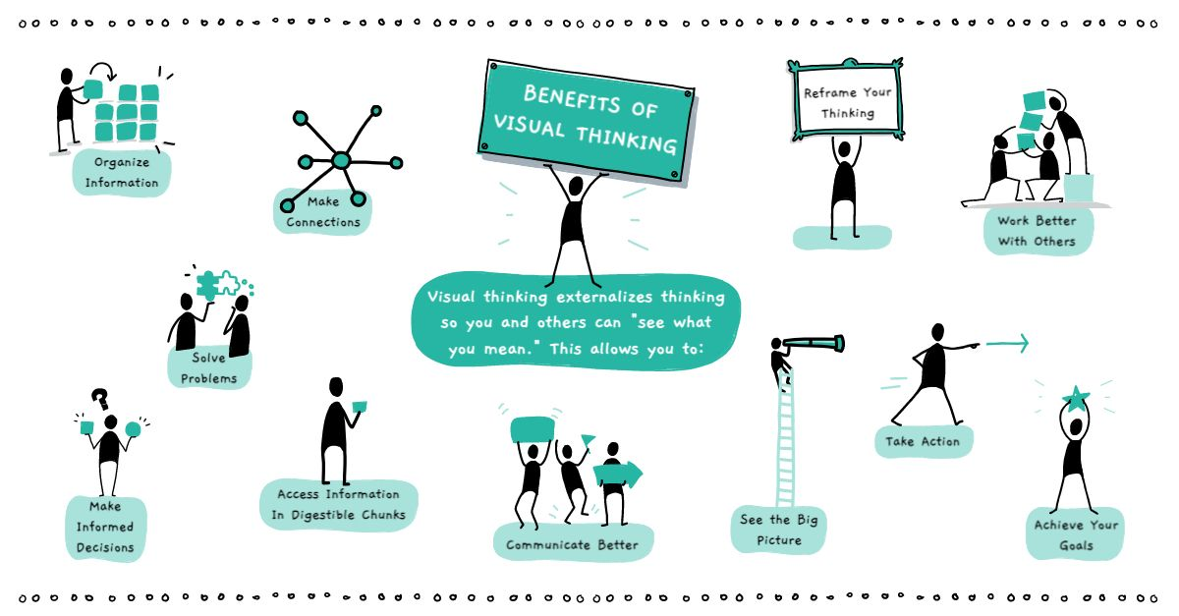
Definition
Visual communication is the practice of using visual elements to get a message across, inspire change, or evoke an emotion.
Source : Drawify

Slide 8
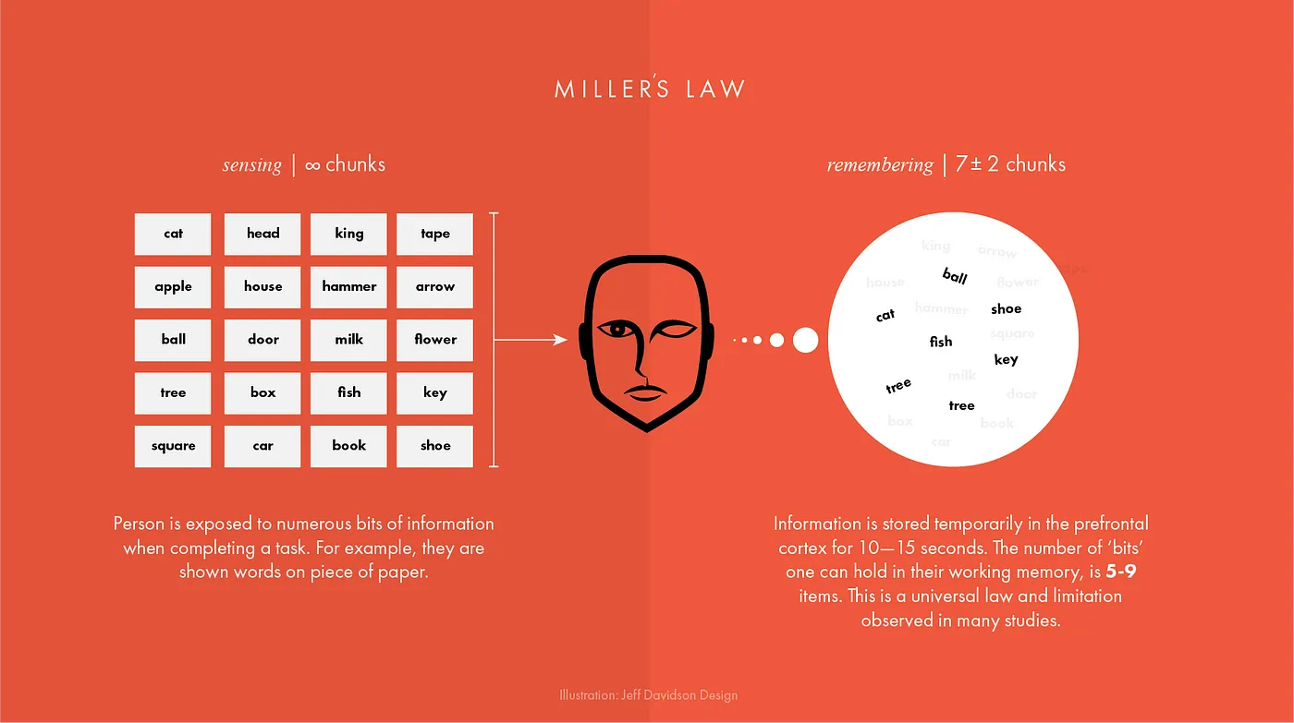
Working Memory
Unique
Tested
Showing the impact of your work by using data visualization
Telling stories through visuals and data
Elephant
Authentic
Creating more memorable information through the use of symbols and icons
Harnessing color to illustrate importance and attract attention
Notes:
The first concept is "chunking" and the capacity of short term memory. Miller (1956) presented the idea that short-term memory could only hold 5-9 chunks of information (seven plus or minus two) where a chunk is any meaningful unit. A chunk could refer to digits, words, chess positions, or people's faces. The concept of chunking and the limited capacity of short term memory became a basic element of all subsequent theories of memory.

Slide 9
George Miller’s Magical Number of Immediate Memory
Unique
Tested
Showing the impact of your work by using data visualization
Telling stories through visuals and data
Elephant
Authentic
Creating more memorable information through the use of symbols and icons
Harnessing color to illustrate importance and attract attention
Notes:
Humans are visually oriented animals with approximately 55% of our cortex is dedicated to processing visual stimuli.
The first concept is "chunking" and the capacity of short term memory. Miller (1956) presented the idea that short-term memory could only hold 5-9 chunks of information (seven plus or minus two) where a chunk is any meaningful unit. A chunk could refer to digits, words, chess positions, or people's faces. The concept of chunking and the limited capacity of short term memory became a basic element of all subsequent theories of memory.

Slide 10

Examples

Slide 11
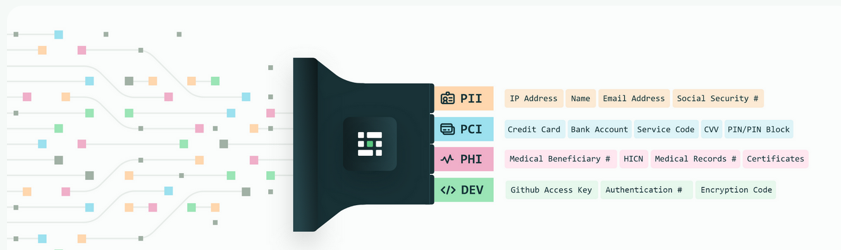
Privacy
Source : Medium blog
Notes:
Personal Identifiable Information (PII) is defined as: Any representation of information that permits the identity of an individual to whom the information applies to be reasonably inferred by either direct or indirect means.

Slide 12
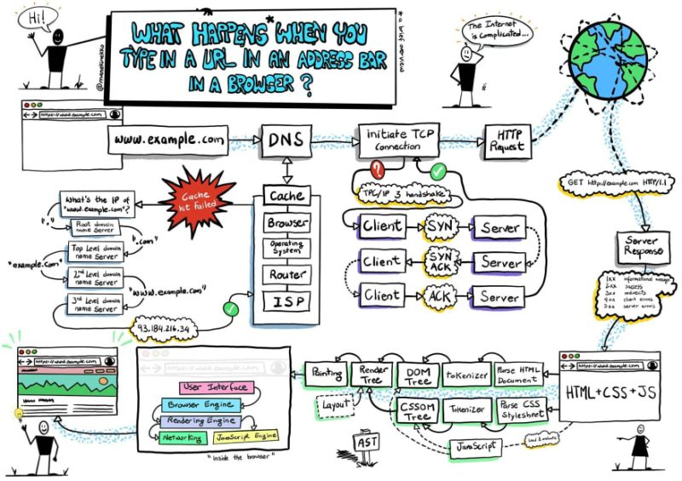
ELI5
Source :
Notes:
Personal Identifiable Information (PII) is defined as: Any representation of information that permits the identity of an individual to whom the information applies to be reasonably inferred by either direct or indirect means.

Slide 13
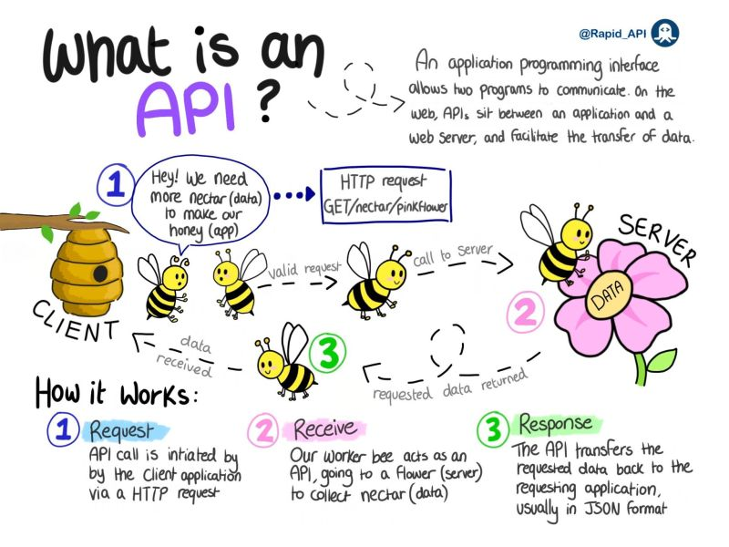
API
Source :
Notes:
Personal Identifiable Information (PII) is defined as: Any representation of information that permits the identity of an individual to whom the information applies to be reasonably inferred by either direct or indirect means.

Slide 14
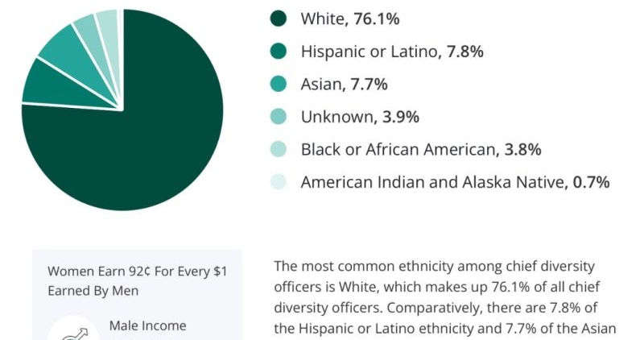
Colors?

Slide 15
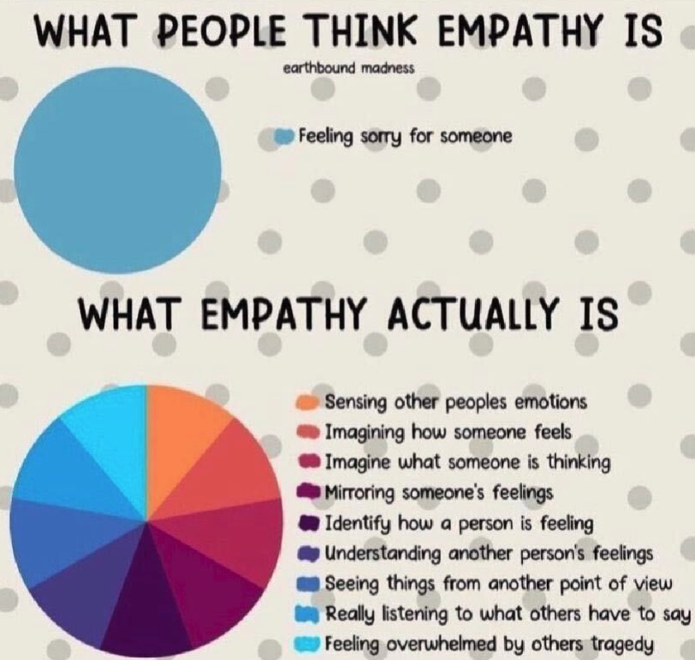
Colors?

Slide 16
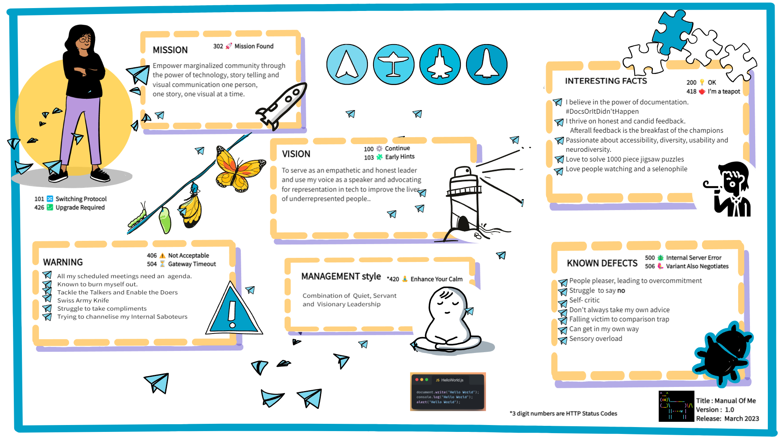
Meet the team

Slide 17
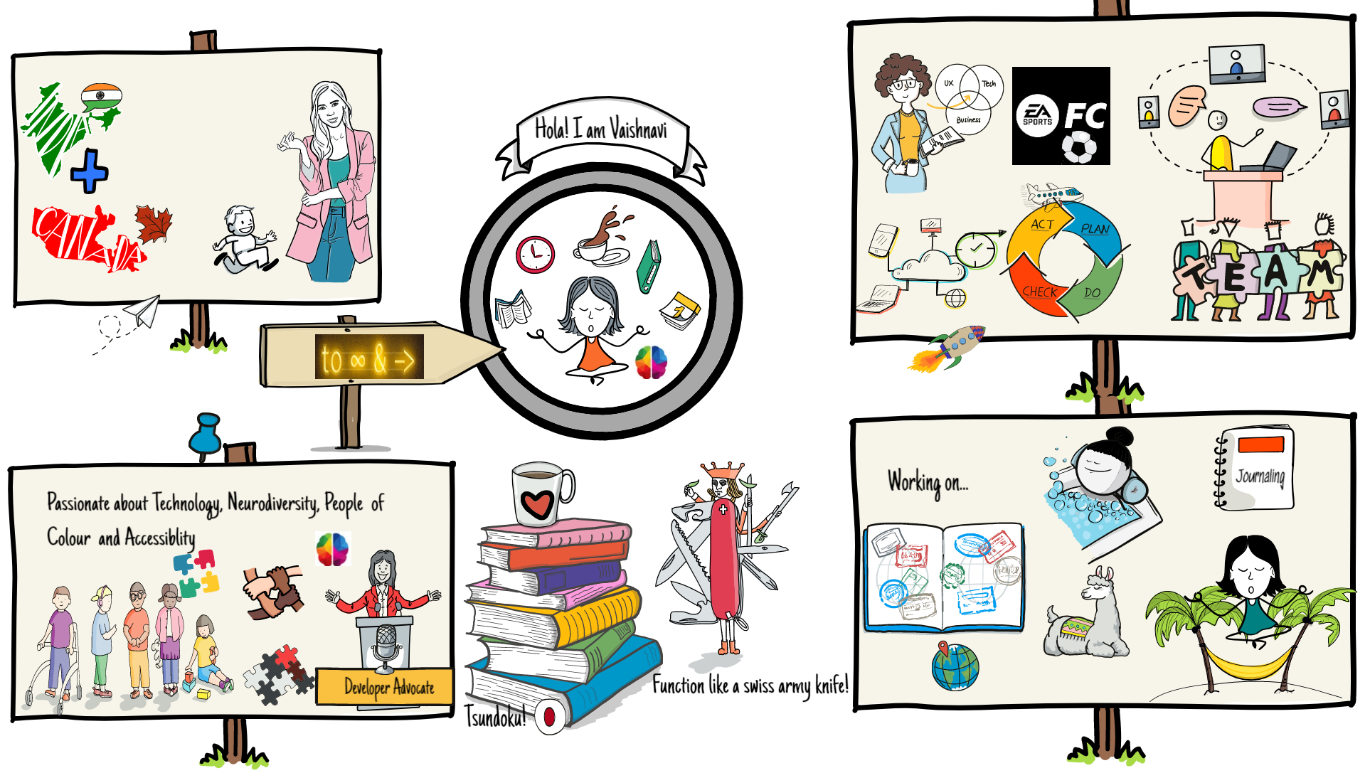
Meet the team

Slide 18
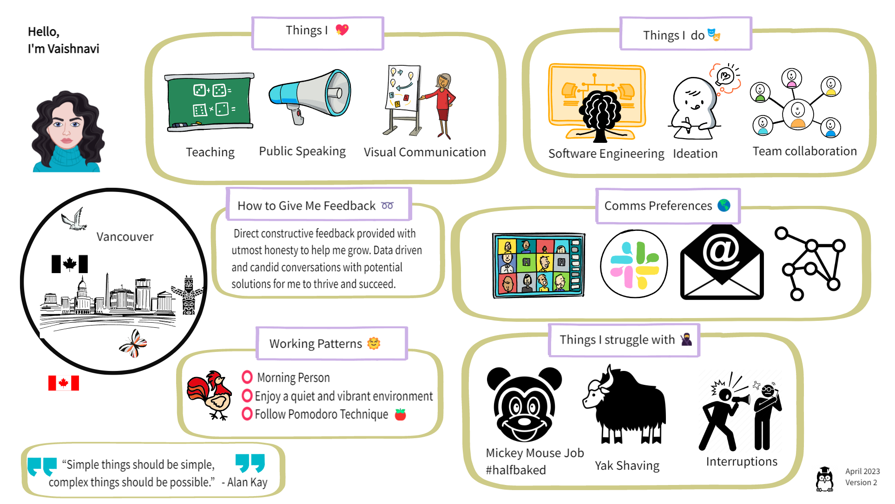

Slide 19
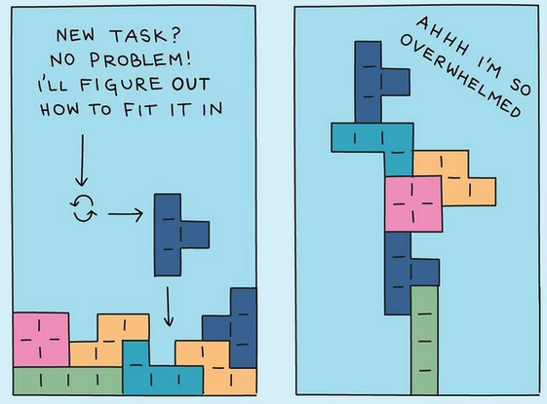
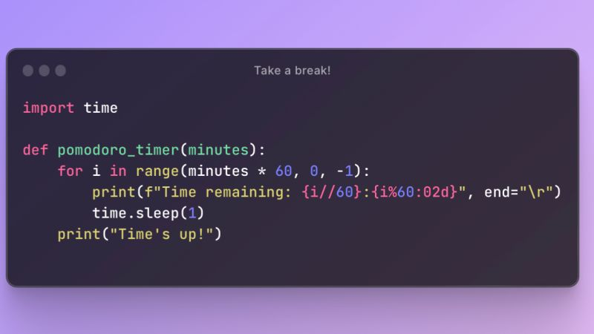

Ideas
$3B
$2B
$ 1B
Opportunity to build
Fully inclusive market
Total addressable market
Freedom to invent
Selectively inclusive market
Serviceable available market
Few competitors
Specifically targeted market
Serviceable obtainable market

Slide 20
Containerization
Think of shipping containers on a boat.
A shipping container is like a Docker container.
A port is a facility that will load/unload, manage, move, inventory, and handle shipping and movement logistics. This is Kubernetes.
Containers are horses and Kubernetes is the Ranch managing those horses.
You decide how many horses in the ranch and the Ranch Manager will make sure to keep that many
horses there at all times. They can also bring other horses from other ranches if one dies to make sure they always have exact amount of horses you specified
Kubernetes automates a lot of the cloud set and forget stuff. How do you have redundancy’s. Tell kubernetes I want 3 of these boom you have three. What’s underneath? Maybe docker. Instead of you doing the scripting docker does it.
Opportunity to build
Fully inclusive market
Total addressable market

Slide 21
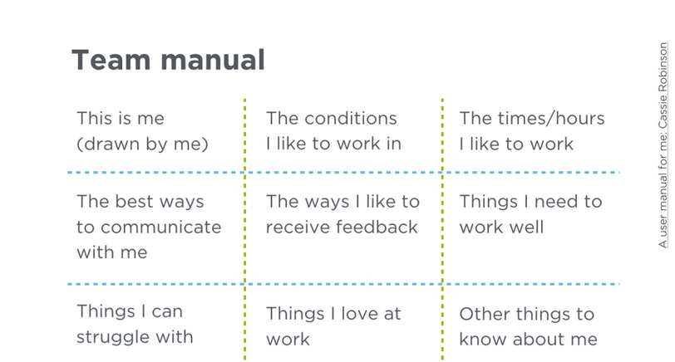

Slide 22
Ideas
$3B
$2B
$ 1B
Opportunity to build
Fully inclusive market
Total addressable market
Freedom to invent
Selectively inclusive market
Serviceable available market
Few competitors
Specifically targeted market
Serviceable obtainable market

Slide 23
Problem
Market gap
Financials
Few, if any, products on the market help customers like we do
Millennials account for about a quarter of the $48 billion spent on other products in 2018
Customers
Costs
66% of US consumers spend money on multiple products that only partially resolves their issue
Loss of productivity costing consumers thousands of dollars

Slide 24

Solution
Close the gap
Our product makes consumer lives easier, and no other product on the market offers the same features
Target audience
Gen Z (18-25 years old)
Cost savings
Reduce expenses for replacement products
Easy to use
Simple design that gives customers the targeted information they need

Slide 25



Business model
Research
Abstract
Design
We based our research on market trends and social media
We believe people need more products specifically dedicated to this niche market
Minimalist and easy to use

Slide 26



Market comparison
$3B
Opportunity to build
Addressable market
$2B
Freedom to invent
Serviceable market
$1B
Few competitors
Obtainable market

Slide 27
Our competition
Contoso
Competitors
Our product is priced below that of other companies on the market
Design is simple and easy to use, compared to the complex designs of the competitors
Affordability is the main draw for our consumers to our product
Company A Product is more expensive
Companies B & C Product is expensive and inconvenient to use
Companies D & E Product is affordable but inconvenient to use

Slide 28
Competitive layout
CONVENIENT
A
Contoso
EXPENSIVE
AFFORDABLE
D
C
E
B
INCONVENIENT

Slide 29
Growth strategy
How we’ll scale in the future
Feb 20XX
May 20XX
Oct 20XX
Roll out product to high profile or top-level participants to help establish the product
Release the product to the general public and monitor press release and social media accounts
Gather feedback and adjust product design as necessary

Slide 30
Traction
Forecasting for success
Key metrics
Revenue by year
 | Clients | Orders | Gross revenue | Net revenue
20XX | 10 | 1100 | $10,000 | $7,000
20XX | 20 | 200 | $20,000 | $16,000
20XX | 30 | 300 | $30,000 | $25,000
20XX | 40 | 400 | $40,000 | $30,000

Slide 31
Two-year action plan
Draft blueprints
Run focus groups
Gather feedback
20XX
JAN
FEB
MAR
APR
MAY
JUN
JUL
AUG
SEP
OCT
NOV
DEC
20XX
JAN
FEB
MAR
APR
MAY
JUN
JUL
AUG
SEP
OCT
NOV
DEC
Test design
Launch design
Deliver to client

Slide 32
Financials
 | Year 1 | Year 2 | Year 3
Income
Users | 50,000 | 400,000 | 1,600,000
Sales | 500,000 | 4,000,000 | 16,000,000
Average price per sale | 75 | 80 | 90
Revenue @ 15% | 5,625,000 | 48,000,000 | 216,000,000
Gross profit | 5,625,000 | 48,000,000 | 216,000,000
Expenses
Sales & marketing | 5,062,500 | 38,400,000 | 151,200,000 | 70%
Customer service | 1,687,500 | 9,600,000 | 21,600,000 | 10%
Product development | 562,500 | 2,400,000 | 10,800,000 | 5%
Research | 281,250 | 2,400,000 | 4,320,000 | 2%
Total expenses | 7,593,750 | 52,800,000 | 187,920,000

Slide 33

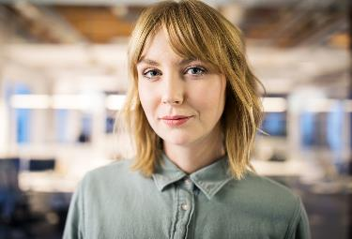






Meet the team
Takuma Hayashi
Mirjam Nilsson
Flora Berggren
Rajesh Santoshi
President
Chief Executive Officer
Chief Operations Officer
VP Marketing
Graham Barnes
Rowan Murphy
Elizabeth Moore
Robin Kline
VP Product
SEO Strategist
Product Designer
Content Developer

Slide 34
Funding
Properties
Angel investments
Cash
Shares
$12,000
$14,000
$32,000
$82,000
Revenue obtained from property rentals
Amount obtained through other investors
Liquid cash we have on hand
Number of shares converted into USD

Slide 35
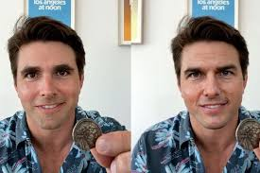
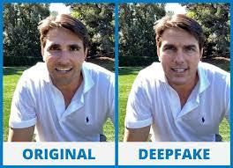
DEEPFAKE TECHNOLOGY: SEEING IS BELIEVING, OR IS IT?

Slide 36

What next?
Convergence
In today's digital world, AI, cloud computing, the internet of things (IoT), and superfast networks such as 5G are the cornerstones, and data is the fuel that drives them all. These technologies are some of the data science latest trends. Together, these technologies enable much more than they can do separately.

Slide 37

Deepfakes, generative AI, and synthetic data
Synthetic faces of people who have never existed can be created to train facial recognition algorithms while avoiding the privacy concerns involved with using real people’s faces.
It can be created to train image recognition systems to spot signs of very rare and infrequently photographed cancers in medical images.
To create language-to-image capabilities, allowing, for example, an architect to produce concept images of a building simply by describing how it will look in words.

Slide 38
Deepfakes, generative AI, and synthetic data
Synthetic voices have been used to help patients with ALS (Amyotrophic Lateral Sclerosis) who, due to the disease, often lose some or all of their ability to speak. With the use of this technology, they can speak with their loved ones with a voice that sounds just like theirs.
For educational purposes, deepfakes can be used to imitate teachers or bring back historical figures.
In film, the accessible nature of deepfakes means that independent creators without huge budgets can create their art.

Slide 39


Thank you

